Slide 1


Facing the politics
of global tax reform
Francis Weyzig
Amsterdam, 9 April 2015

Slide 2

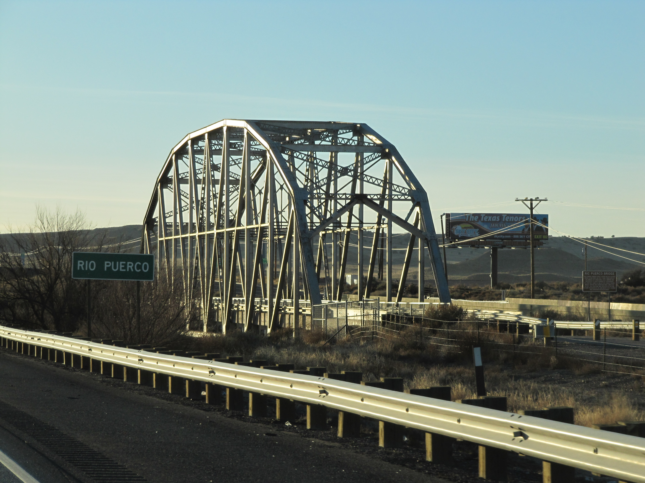


Slide 3
1. Tax treaty abuse

Slide 4
Tax treaty abuse
Spillover effects: withholding tax policy affects treaty partner
OECD solution: 3 types of anti-abuse clauses & domestic law
Implementation: amending treaty networks & multilateral instrument

Slide 5
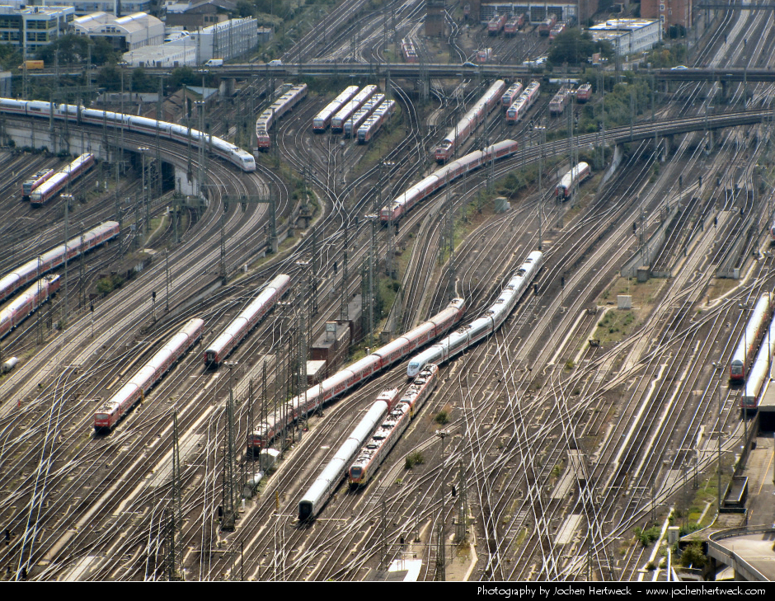

Slide 6
Facing the politics
No agreement on preferred type of anti-abuse clause → complex
No mechanism to ensure non-OECD countries cooperate (e.g. Mauritius, UAE) → weak

Slide 7
2. Harmful tax practices

Slide 8
Harmful tax practices
Spillover effects: shifting profits to other countries with low-tax regime
OECD solution: changing rules for transfer pricing (arm’s length principle)
OECD & EU solution: addressing special regimes (nexus approach for IP)

Slide 9


Slide 10
Facing the politics
No action against non-preferential tax regimes with similar spillover effects → weak
No change of IP regimes required before 2021 → weak
Nexus approach: attribution of R&D costs → complex

Slide 11
3. Tax transparency
(behind closed doors)

Slide 12
Tax transparency (behind closed doors)
Spillover effects: lack of disclosure facilitates international tax dodging
OECD & EU solution: confidential exchange of rulings
OECD solution: confidential exchange of country-by-country data

Slide 13
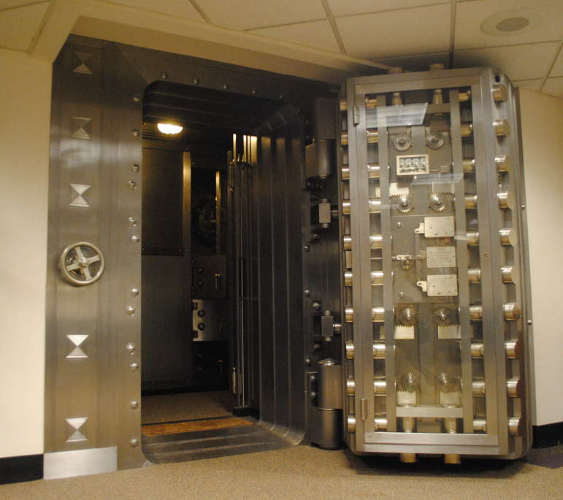

Slide 14
Facing the politics
No public scrutiny → weak
No data to guide policy making, including by OECD itself → weak
Exchange of data requires implementation agreements between all countries → complex

Slide 15
Conclusion:
Time to face the politics
of global tax reform
or else solutions will be
too weak and too complex

Slide 16
Thank you!
Francis Weyzig
francis.weyzig@oxfamnovib.nl

